Slide 1

Chapter 1 Part 3
Database Systems
The slides in this presentation have been adapted from slides provided with the textbook, Database Systems: Design, Implementation, and Management, 12E, Cornel and Morris, Copyright © 2017 Cengage Learning.

Slide 2
Learning Objectives
The main components of the database system
The main functions of a database management system (DBMS)
Copyright © 2017 Cengage Learning
2

Slide 3
Database Systems
Logically related data stored in a single logical data repository
Physically distributed among multiple storage facilities
DBMS eliminates most of file system’s problems
Current generation DBMS software:
Stores data structures, relationships between structures, and access paths
Defines, stores, and manages all access paths and components
Copyright © 2017 Cengage Learning
3

Slide 4
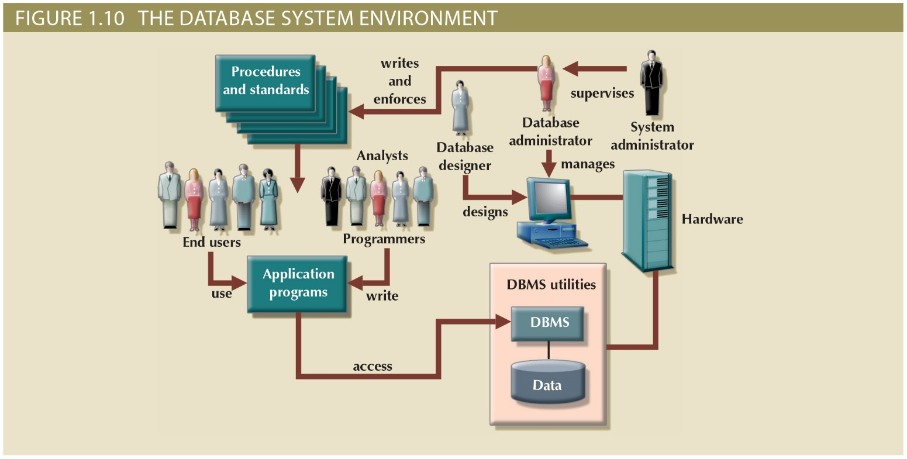
Figure 1.9 - The Database System Environment
Copyright © 2017 Cengage Learning
4

Slide 5
DBMS Functions
Most functions are transparent to end users
Can only be achieved through the DBMS
Data dictionary management
DBMS stores definitions of data elements and relationships (metadata) in a data dictionary
DBMS looks up required data component structures and relationships
Changes automatically recorded in the dictionary
DBMS provides data abstraction and removes structural and data dependency
Copyright © 2017 Cengage Learning
5

Slide 6
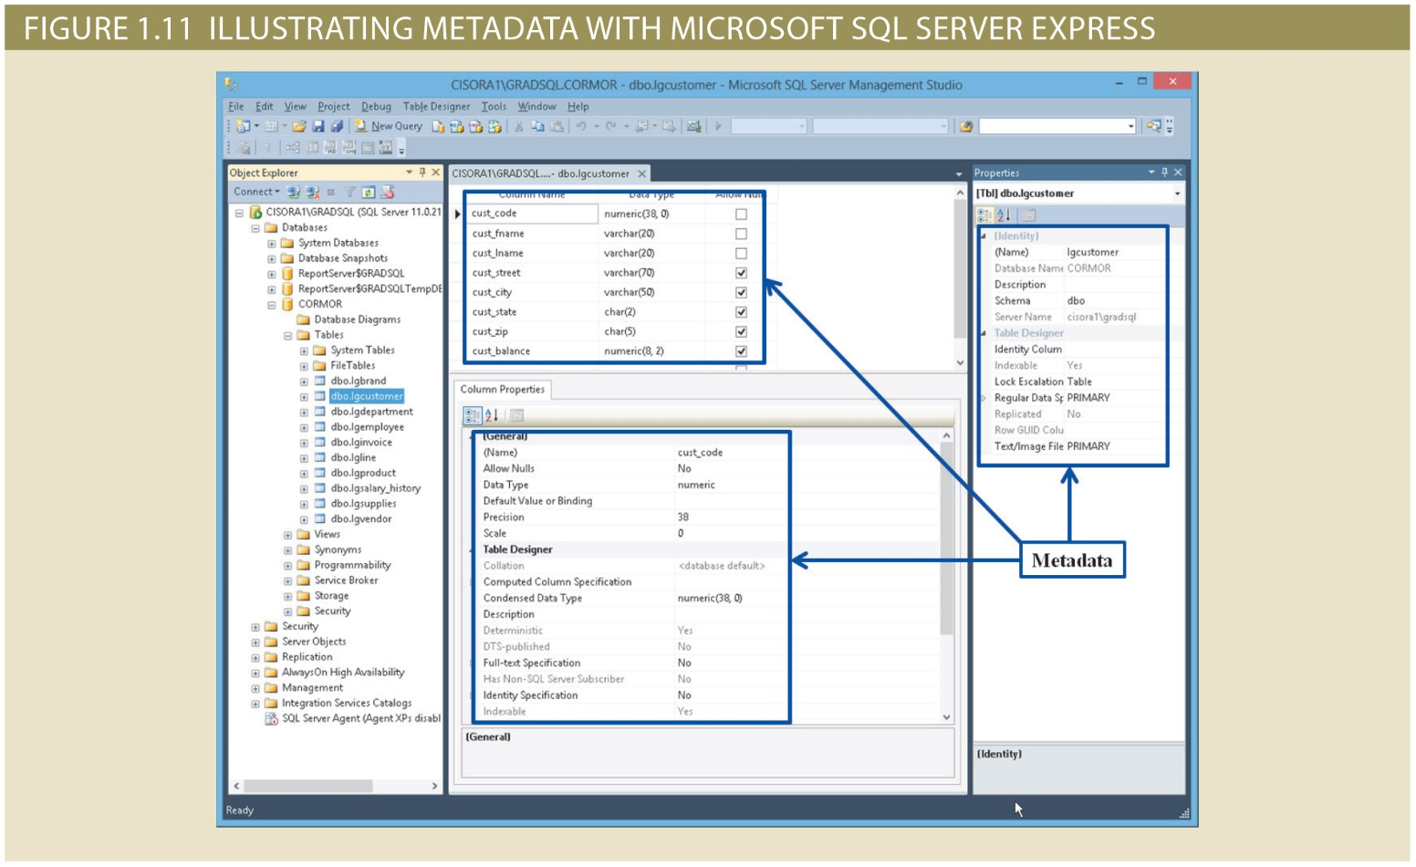
Copyright © 2017 Cengage Learning
6

Slide 7
DBMS Functions (cont'd.)
Data storage management
DBMS creates and manages complex structures required for data storage
Also stores related data entry forms, screen definitions, report definitions, etc.
Performance tuning: activities that make the database perform more efficiently
DBMS stores the database in multiple physical data files
Copyright © 2017 Cengage Learning
7

Slide 8
DBMS Functions (cont'd.)
Data transformation and presentation
DBMS transforms data entered to conform to required data structures
DBMS transforms physically retrieved data to conform to user’s logical expectations
Security management
DBMS creates a security system that enforces user security and data privacy
Security rules determine which users can access the database, which items can be accessed, etc.
Copyright © 2017 Cengage Learning
9

Slide 9
DBMS Functions (cont'd.)
Multiuser access control
DBMS uses sophisticated algorithms to ensure concurrent access does not affect integrity
Backup and recovery management
DBMS provides backup and data recovery to ensure data safety and integrity
Recovery management deals with recovery of database after a failure
Critical to preserving database’s integrity
Copyright © 2017 Cengage Learning
10

Slide 10
DBMS Functions (cont'd.)
Data integrity management
DBMS promotes and enforces integrity rules
Minimizes redundancy
Maximizes consistency
Data relationships stored in data dictionary used to enforce data integrity
Integrity is especially important in transaction-oriented database systems
Copyright © 2017 Cengage Learning
11

Slide 11
DBMS Functions (cont'd.)
Database access languages and application programming interfaces
DBMS provides access through a query language
Query language is a nonprocedural language
Structured Query Language (SQL) is the de facto query language
Standard supported by majority of DBMS vendors
Copyright © 2017 Cengage Learning
12

Slide 12
DBMS Functions (cont'd.)
Database communication interfaces
Current DBMSs accept end-user requests via multiple different network environments
Communications accomplished in several ways:
End users generate answers to queries by filling in screen forms through Web browser
DBMS automatically publishes predefined reports on a Web site
DBMS connects to third-party systems to distribute information via e-mail
Copyright © 2017 Cengage Learning
13

Slide 13
Disadvantages of Database Systems
Increased costs
Management complexity
Maintaining currency
Vendor dependence
Frequent upgrade/replacement cycles
Copyright © 2017 Cengage Learning
14

Slide 14
Summary
Most systems today use a database
DBMS is the natural evolution of file systems
Provides many significant advantages
Data Redundancy, Data Independence, and Data Anomalies
Copyright © 2017 Cengage Learning
16

Slide 15
Task
What is the definition of a database: ___________________________________
What is the most important function that DBMSs provide for organizations? ___________________________________
What is the biggest disadvantage of using a database? ___________________________________
Copyright © 2017 Cengage Learning
17

